Slide 1
Bray Team Week 13 Update
Avery Haynes, Locke Lehmann, Travis Carlson, Cody Sims, Zachary Walker, Michael Hager
11/13/2023

Slide 2
Problem Statement Summary
Develop a method to internally measure valve position independent of an actuator, measure actuator output torque, and detect fluid leakage to increase the valve's service life.
Priorities: position and torque
Bray cares about all three, customers care about torque and leakage
Existing solution: IOT Torque Bracket

Slide 3
Week 12 Deliverables
Week 12 Tasks
Deliverable | Team Member | Percent Completed | Notes
Finish preliminary budget and submit | Avery | 100%
Discuss cost items and next steps with Bray | All | 100% | Discussed with Bray, we can use some valves of theirs
Create more detailed plan for design implementation | All | 15% | More details about fit, installation, potentially using Bray's spare valves

Slide 4
Week 13 Plans
Week 13 Tasks
Deliverable | Team Member | Percent Completed | Notes
Make detailed validation plan | All | 15% | Talk to Bray about specifics today
Research potentiometers on the market and find best fit for design | All | 25%
Research valve sealing standards | All | 0% | Figure out how to implement the rotary potentiometer without breaking valve standards
Validate the accuracy of the rotary potentiometer | All | 0% | Need to contact the common labs and set up a time
Contact Common Labs to set up a time to run validation test | Locke | 0%

Slide 5
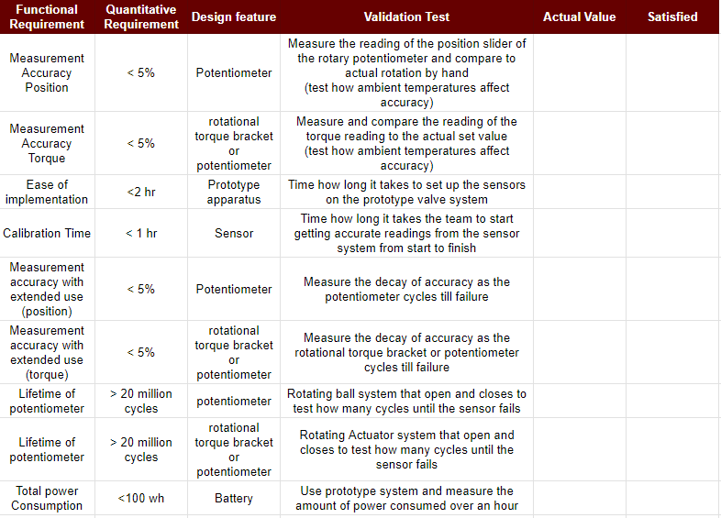
Validation Planning

Slide 6
Validation Planning
Bray has a test rig at their facility that we could possibly perform repetitive accuracy testing for sensor lifetime
Need to set a timeline with bray for the lifetime testing
We can use a valve to test accuracy (sensor reading versus visual verification)
Will use a daq system to collect data from the validation planning

Slide 7
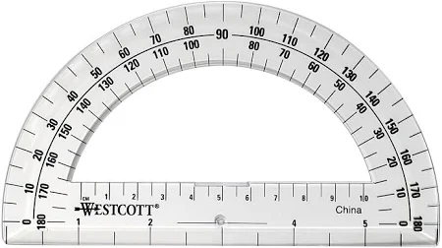
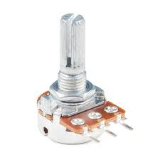
Testing Apparatus

Slide 8
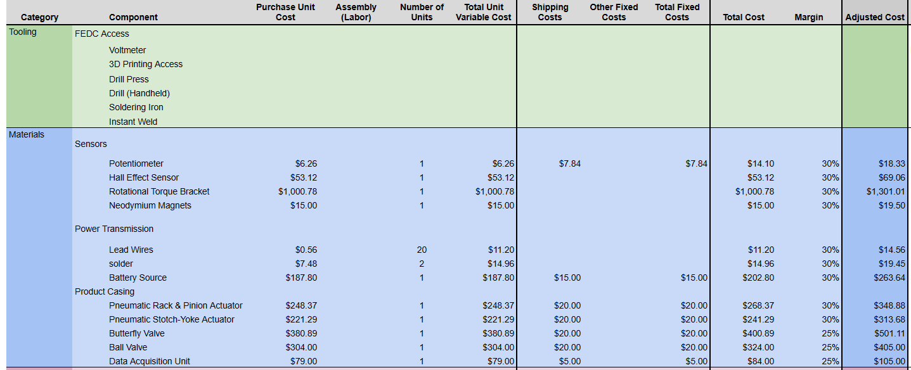
Budget Estimate (Revised)

Slide 9
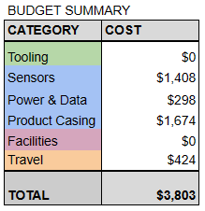
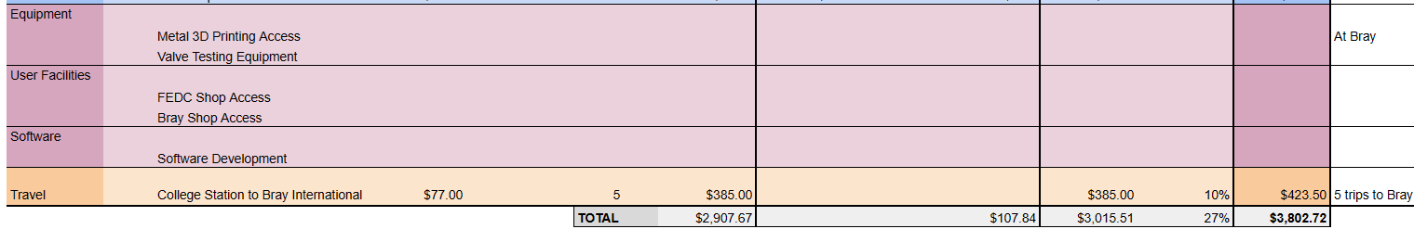
Budget Estimate (Revised)

Slide 10
Sponsor Thoughts
Approved of final design concept for position (potentiometer)
Consider Force sensor or rotary potentiometer for torque measurement
With the potentiometer located at the bottom and cut into the casing have to make sure the valve still meets the codes and standards
New final presentation date: 12/1, 3:45 PM

Slide 11
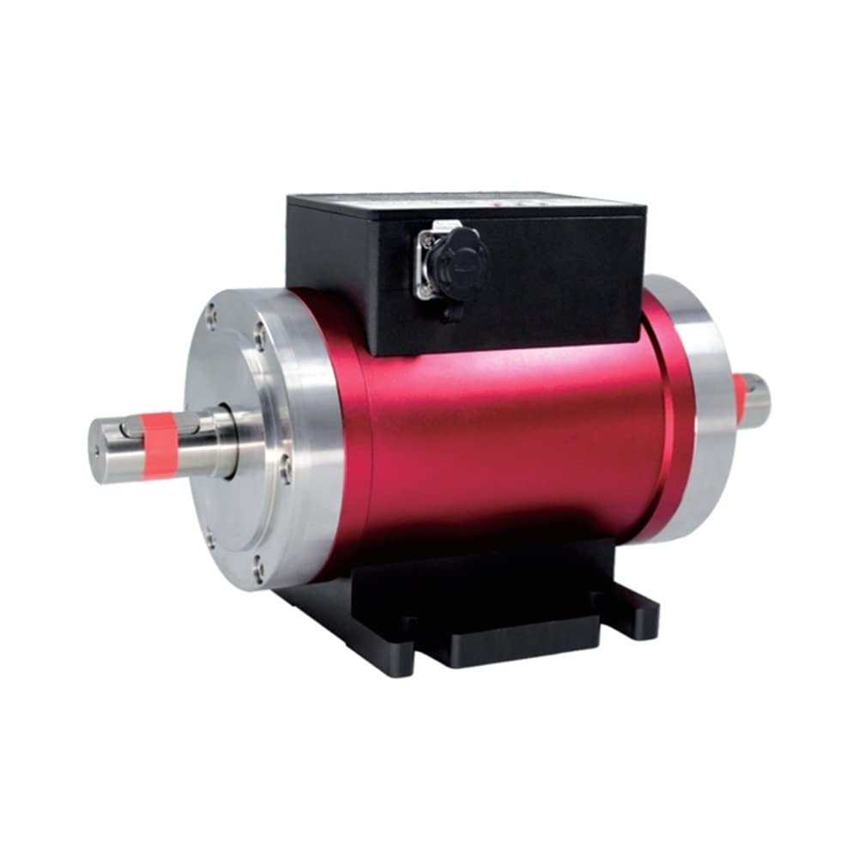
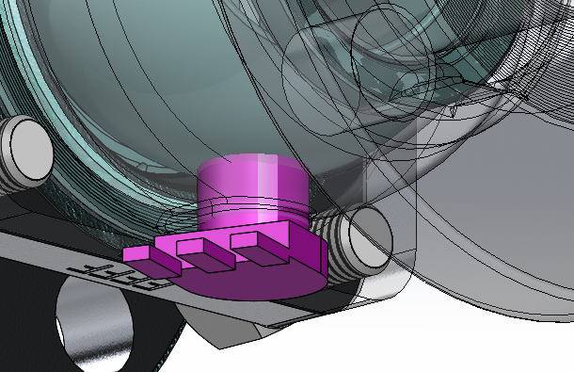
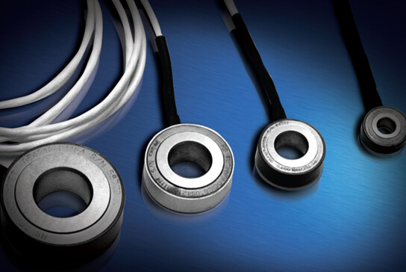
Embodiment Design

Slide 12
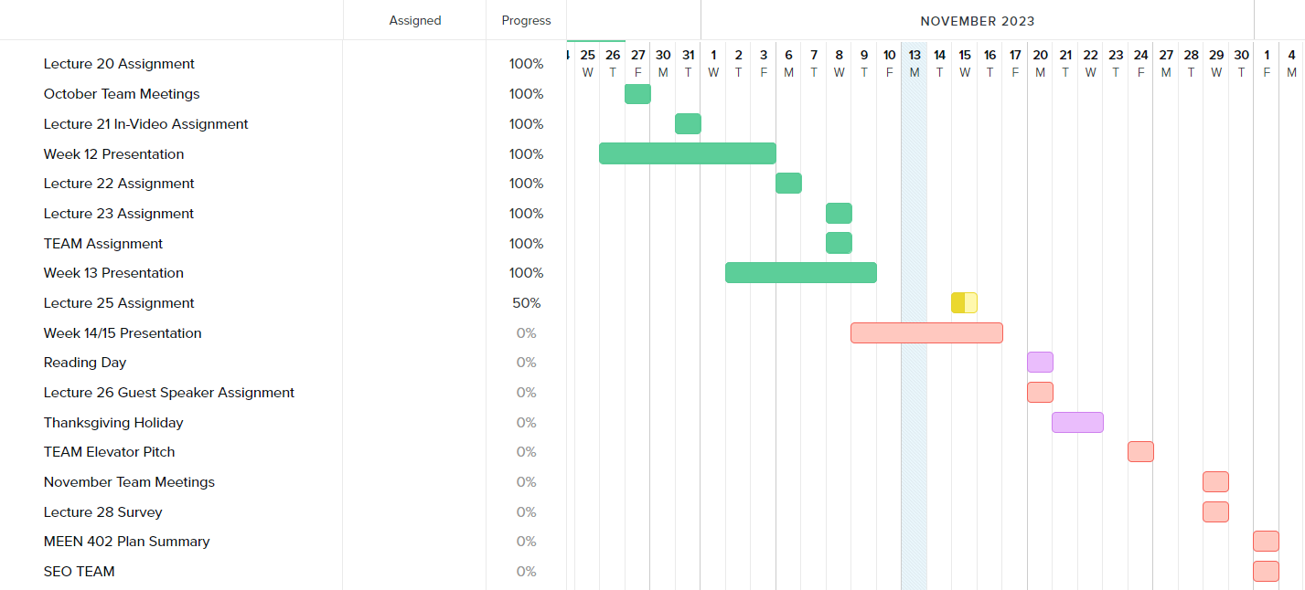
Gantt Chart

Slide 13


Any questions?
(This slideshow is dedicated to the memory of Jimbo Fisher)

